Slide 1
Lecture 14: Roadmap
Transmission Modes :
  Parallel Transmission
  Serial Transmission,
    Asynchronous transmission
    synchronous transmission
    Isochronous transmission

Slide 2
TRANSMISSION MODES
The transmission of binary data across a link can be accomplished in either parallel or serial mode. In parallel mode, multiple bits are sent with each clock tick. In serial mode, 1 bit is sent with each clock tick. While there is only one way to send parallel data, there are three subclasses of serial transmission: asynchronous, synchronous, and isochronous.

Slide 3

Data transmission and modes

Slide 4
Serial Parallel
Only One bit is sent with each clock pulse
Only one communication line is needed
Low speed
Reduced Cost
Used for long Distance transmission
E.g. computer to computer links (synchronous), keyboard to computer. (asynchronous) etc.
Multiple bits are sent with each clock pulse
To transmit n bits at a time, n communication lines are needed
High speed
More Expensive
Used for short distance Transmission
E.g. Internal computer signal paths, I/O devices etc.

Slide 5
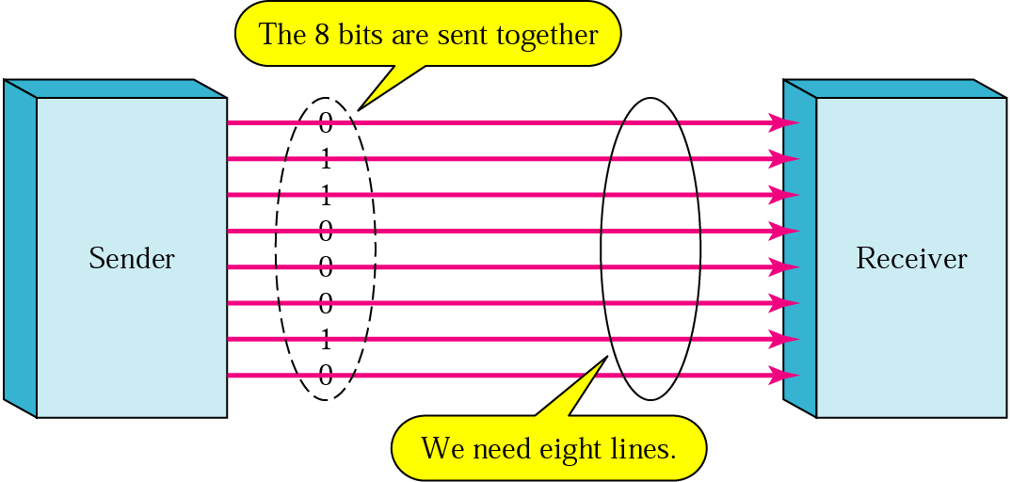
Parallel transmission

Slide 6
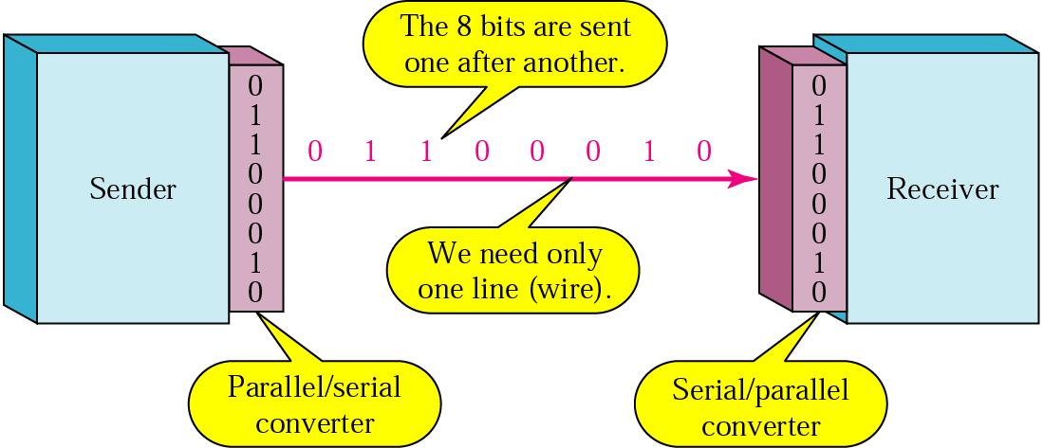
Serial transmission

Slide 7
Bit Synchronization
To correctly interpret the bits coming from the source, the receiver has to know when to look at the line to take the bits off the line.
This is done by means of a clock at each end of the line.
The source clock tells the source how often to put the bits onto the line, and the receiver clock tells how often to look at the line

Slide 8
Asynchronous Synchronous
Data is transmitted character by character
Uses Start bit and Stop bit to specify the start and end of a character
Start and stop bits must be of opposite polarity
Useful for data that has unpredictable gaps (Keyboard to computer)
High overhead
Simple and cheap
No synchronization is required at the bit level. Only for the duration of a single character or byte.
Data is transmitted in blocks called frames
Use Preamble and Postamble to specify the start and end of the block of data
Useful for high speed data transmission with no intervals between characters. (computer to computer)
Low overhead.
Synchronization is achieved by using self clocking codes (like Manchester)

Slide 9

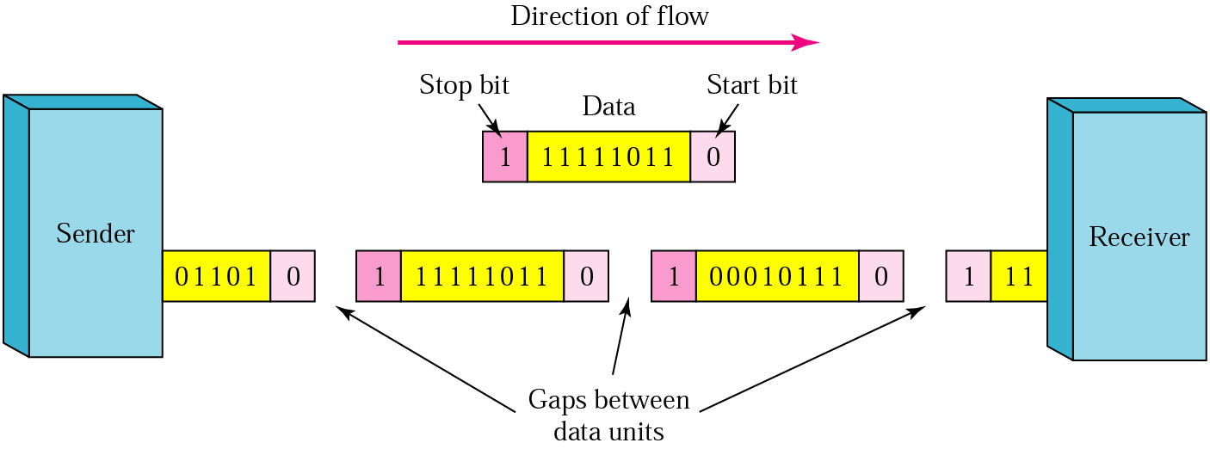
Asynchronous transmission

Slide 10
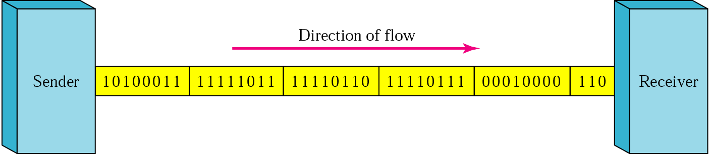
Synchronous transmission

Slide 11
isochronous
In this serial transmission, in addition to synchronous transmission Gap between frames are also consistent. Require in live Video or audio application.

Slide 12
Overhead
Overhead
  Non-data bits or characters necessary for transmission, error detection or for use by protocol.
  Example:
    For asynchronous transmission: start and stop bits
    For synchronous transmission: preamble, postamble and control fields

Slide 13
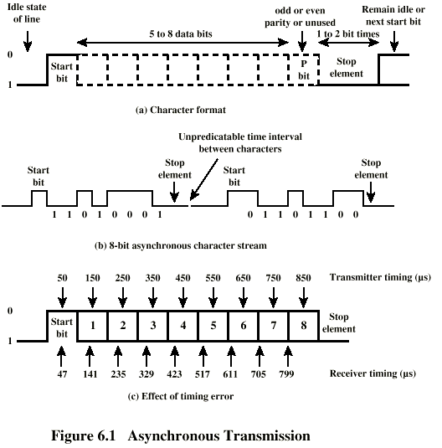
Asynchronous (diagram)

Slide 14
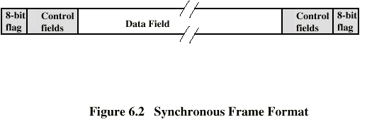
Synchronous (diagram)

Slide 15
Efficiency of Transmission
Asynchronous Transmission
  Example
    Every character has 8 bits + 1 start bit + 2 stop bits
      No. of data bits = 8 bits
      No. of overhead bits = 3 bits
  Transmission Efficiency = Total No. of data bits / Total bits = 8 / 11 = 73%
Synchronous Transmission
  Example
    A block of 240 (8-bit each) characters + 8 bits for preamble + 8 bits for postamble + 8 bits for control info + 8 bits for checksum etc.
      No. of data bits = 240 x 8 = 1920 bits
      No. of overhead bits = 4 x 8 = 32 bits
  Transmission Efficiency = Total No. of data bits / Total bits = 1920 / (1920 + 32) = 98.36%

